Slide 1
Senior External Verifier
Review – 2016/17
Kim Tree

Slide 2
General Feedback
The HN Framework update to FRS102 has now been fully updated.
Updates to units in other frameworks (eg Construction) was completed to bring them in line re terminology and error tolerances
Internal Assessment Report now Qualification Verification Summary
NC Accounting is in the process of being revised

Slide 3
Resources
There is evidence of more sharing of resources across the sector
Sharing of alternative assessments is useful
Feedback on Assessment Support Packs (ASPs) helpful
Important to remember they are examples
Minor amendments should be noted in IV process
Alternatives to solutions should be retained and documented in IV records

Slide 4
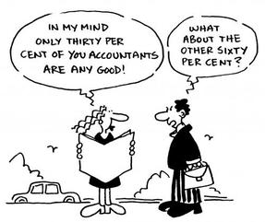
HN Accoounting

Slide 5
HN Accounting - today.
Strengths | Updated recently | High uptake | Prepares for workplace | Practical
Weaknesses | Limits to communication skills opportunities | Keeping up to date | Annual updates required
Opportunities | Encourage PDA uptake | Part-time
Threats | Universities | Experienced staff | CPD limited | Annual tax updates

Slide 6
General Feedback
Important to identify clearly errors of principle and arithmetic
Clear rationale recorded for selection of ASP
Alternatives to solutions should be retained and documented in IV records. Good practice to retain examples of scripts for future reference
Prompt opportunity for reassessment
Clear recording of any disputed assessment decisions

Slide 7
General Feedback (contd)
Update bulletins regularly – make sure you keep a track of the content (Centre News, etc)
Clear records of IV meetings and discussions
Regular review of HN Accounting web page
Maintain results for whole cohort and present for review
Retain amended marking schemes to ensure consistency
Apply marking procedures consistently across campuses/sites

Slide 8
Unit Specifications
Welcome feedback if Unit Specifications (US) need to be updated
Not always funds to do so
US clearly state the conditions of assessment
Acceptable use of computers for assessment completion noted in US
If closed book – not acceptable to provide any pro-forma UNLESS allowable in US
Spreadsheets not to be used for book-keeping assessments.

